Slide 1
Applications over P2P Structured Overlays
Antonino Virgillito

Slide 2
General Idea
Exploiting DHTs as a basic routing layer, providing self-organization in face of system dynamicity
Enable the realization of large-scale applications with stronger semantics than DHTs
Examples:
  Replicated storage
  Access control (quorums)
  Multicast (topic-based or content-based)

Slide 3
PAST: Cooperative, archival file storage and distribution
Layered on top of Pastry
Strong persistence
High availability
Scalability
Reduced cost (no backup)
Efficient use of pooled resources

Slide 4
PAST API
Insert - store replica of a file at k diverse storage nodes
Lookup - retrieve file from a nearby live storage node that holds a copy
Reclaim - free storage associated with a file
Files are immutable

Slide 5

PAST: File storage
k=4
Storage Invariant:
File “replicas” are
stored on k nodes
with nodeIds
closest to fileId
(k is bounded by the leaf set size)
fileId
Insert fileId
Notes:
PAST file storage is mapped onto the Pastry overlay network by maintaing the invariant that replicas of a file are stored on the k nodes that are numerically closest to the file’s numeric fileId.
During an insert operation, an insert request for the file is routed using the fileId as the key. The node closest to fileId replicates the file on the k-1 next nearest nodes in then namespace.

Slide 6
PAST: File Retrieval
C
k replicas
Lookup
fileId
file located in log₁₆ N steps (expected)
usually locates replica nearest client C
Notes:
The last point is shown pictorally here.
A lookup request is routed in at most log₁₆ N steps to a node that stores a replica, if one exists.
In practice, the node among the k that first receives the message serves the file.
Furthermore, network locality properties of Pastry (not discussed in this talk) ensure that this is node is usually the node that is closest to the client in the network !!

Slide 7
PAST: Caching
Nodes cache files in the unused portion of their allocated disk space
Files caches on nodes along the route of lookup and insert messages
Goals:
maximize query xput for popular documents
balance query load
improve client latency

Slide 8
SCRIBE: Large-scale, decentralized multicast
Infrastructure to support topic-based publish-subscribe applications
Scalable: large numbers of topics, subscribers, wide range of subscribers/topic
Efficient: low delay, low link stress, low node overhead

Slide 9
SCRIBE: Large scale multicast
topicId
Publish topicId
Subscribe topicId
Notes:
PAST file storage is mapped onto the Pastry overlay network by maintaing the invariant that replicas of a file are stored on the k nodes that are numerically closest to the file’s numeric fileId.
During an insert operation, an insert request for the file is routed using the fileId as the key. The node closest to fileId replicates the file on the k-1 next nearest nodes in then namespace.

Slide 10
PAST: Exploiting Pastry
Random, uniformly distributed nodeIds
  replicas stored on diverse nodes
Uniformly distributed fileIds
  e.g. SHA-1(filename,public key, salt)
  approximate load balance
Pastry routes to closest live nodeId
  availability, fault-tolerance
Notes:
A number of interesting properties emerge:
since nodeId assignment is random, neighboring nodes in namespace are diverse in location, ownership, jurisdiction, network attachment -- thus, excellent candidates for storing replicas of a file.
fileId are pseudo-randomly assigned and, like nodeIds, uniformly distributed in the namespace. Thus the number of files assigned to each node is roughly balanced.
Pastry routes requests to live node with closest nodeId. Thus, file is available unless all k nodes die simultaneously.

Slide 11
Content-based pub/sub over DHTs
Scribe only provides basic topic-based semantics
  Can easily map topics to keys
What about content-based pub/sub?

Slide 12
System model
Pub/sub system: Set N of nodes acting as publishers and/or subscribers of information
Subscriptions and events defined over an
n-dimensional event space
  Subscription: conjunction of constraints
a₂
event
subscription
Content-based subscriptions can include range constraints
a₁

Slide 13
System model
Rendezvous-based architecture: Each node is responsible for a partition of the event space
  Storing subscriptions, matching events
σ
σ
σ
e
σ
σ
σ
e
Problem: difficult to define mapping functions when the set of nodes changes over time

Slide 14
Our Solution: Basic Architecture
Application
Event space is mapped into the universe of keys (fixed)
sub()
unsub()
pub()
notify()
CB-pub/sub
Subs
ak-mapping
Stateless mapping:
Does not depend on execution history (subscriptions, node joins and leaves)
send()
delivery()
join()
leave()
Structured Overlay
kn-mapping
Overlay maintains consistency of KN mapping
Notes:
Say that there’s no need for coordination

Slide 15
Proposed Stateless Mappings
We propose three instantiations of ak-mappings
  Functions: SK(σ) and EK(e)
  SK(σ) and EK(e) have to intersect on at least one value if e matches σ
General principle for range constraints:
  applying a hash function h to each value that matches the constraint
range
Event space
ak-mapping
Key space
kn-mapping
Physical Nodes

Slide 16
Stateless Mappings
Mapping 1: Attribute Split
a₁
a₂
Event Space
a₃
Key Space
SK(σ) = {h(σ.c₁), h(σ.c₂), h(σ.c₃)}
EK(e) = {h(e.a_{i})}

Slide 17
Stateless Mappings
Mapping 3: Selective Attribute
a₁
a₂
Event Space
a₃
Key Space
SK(σ) = {h(σ.c_{i})}
EK(e) = {h(e.a₁), h(e.a₂), h(e.a₃)}

Slide 18
Stateless Mappings
Mapping 2: Key-Space Split
a₁
a₂
Event Space
a₃
Key Space
SK(σ) = {h(σ.c₁) × h(σ.c₂) × h(σ.c₂)}
EK(e₁) = h(e₁.a₁) ° h(e₁.a₂) ° h(e₁.a₂)

Slide 19
Stateless mappings: example
Mapping 1
c₁
c₂
SK(σ₁) = {h(σ₁.c₁), h(σ₁.c₂)}
σ₁
a₁<2
3 < a₂<7
h(σ₁.c₁) = { h(0), h(1) } = {0000, 0001}
h(σ₁.c₂) = { h(4), h(5), h(6) } = {0100,0101,0110}
e₁
a₁=1
a₂=6
EK(e₁) = {h(e₁.a₁), h(e₁.a₂)}
h(e₁.a₁) = h(1) = 0001
h(e₁.a₂) = h(6) = 0110
Mapping 2
Mapping 3
SK(σ₁) = {h(σ₁.c₁) × h(σ₁.c₂)} = {0010, 0011}
SK(σ₁) = {h(σ₁.c₂)}
h(σ₁.c₁) = { h(0), h(1) } = {00, 00}
h(σ₁.c₂) = { h(4), h(5), h(6) } = {10, 10, 11}
h(σ₁.c₂) = { h(4), h(5), h(6) } = {0100,0101,0110}
EK(e₁) = {h(e₁.a₁), h(e₁.a₂)}
EK(e₁) = h(e₁.a₁) ° h(e₁.a₂) = 0011
h(e₁.a₁) = h(1) = 0001
h(e₁.a₂) = h(6) = 0110
h(e₁.a₁) = h(1) = 00
h(e₁.a₂) = h(6) = 11

Slide 20
Stateless mappings: analysis
We compared the mappings with respect to the number of keys returned in average for a subscription
Mapping 2 outperforms other mappings when no selective attributes are present
Mapping 3 represents a good solution with selective attribute

Slide 21
Inefficiencies of the Basic Architecture
Utilizing the unicast primitive of structured overlays for one-to-many communication leads to inefficient behavior
k₁
k₂
k₃
k₄
n₁
n₂
n₃
n₄
n₅
send(σ,k₁)
send(σ,k₂)
send(σ,k₃)
Multiple delivery
send(σ,k₄)
Non-optimal paths

Slide 22
Multicast Primitive
We propose to extend the basic architecture with a multicast primitive msend(m, K) integrated within the overlay
Receives a set of keys K as parameters
Exploits routing table for finding efficient routing paths
Each node in the set receives a message at most once
We provided a specific implementation for the Chord overlay

Slide 23
Multicast Primitive Specification
k₁
k₂
k₃
k₄
msend(σ,{k₁, k₂, k₃, k₄})
n₁
n₂
n₃
n₄
n₅
msend(σ,{k₁, k₂})
msend(σ,{k₃})
msend(σ,{k₃, k₄})
msend(σ,{k₄})
m-cast(M,K) is invoked over a message M and set of target keys K
For any finger f_{i}, a mcast(M, k_{i}) message is sent with the set of keys k_{i} included between f_{i-1} and f_{i}
A node receiving a m-cast(M,k_{i}) delivers M if it is responsible for some keys k_{t} in k_{i} and recursively invokes m-cast(M,k_{i}-k_{t}) on the remaining keys

Slide 24
Other optimizations
We introduced other optimizations for further enhancing the scalability of our approach
Buffering notifications
  Delays notifications and gathers them in batches to be sent periodically
Collecting notifications
  One node per subscription collects all the notifications produced by all the rendezvous
Discretization of mappings
  Coarse subdivision of the event space for reducing the number of rendezvous nodes

Slide 25
Simulations
We implemented a simulator of our system on top of the Chord simulator
We extended the Chord simulator by implementing the multicast primitive
Experiments were performed using different workloads
  Selective and non-selective attributes with Uniform and Zipf distributions

Slide 26
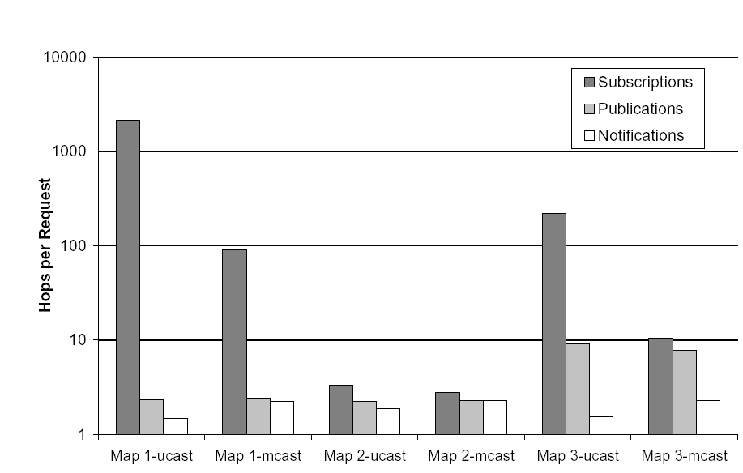
Experimental Results
90% reduction due to mcast
in mapping 3
Best performance with mapping 2
500 nodes, 4 attributes, uniform distribution, non-selective

Slide 27
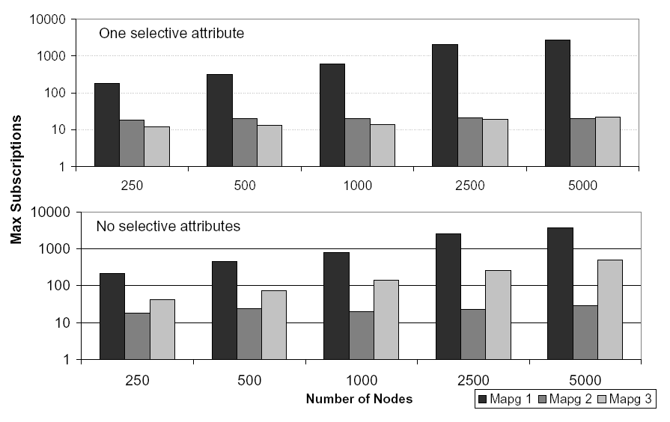
Experimental Results
Good overall scalability of mappings 2 and 3
25000 subscriptions

Slide 28
Future Work
Nearly-stateless mappings for adaptive load balancing
Persistence of subscriptions and reliable delivery of events
Implementation over a real DHT implementation (e.g. OpenDHT)
Experiments on PlanetLab

